Slide 1
CUNY Energy Cost and Distribution
Presented by:
Jonathan Eng

Slide 2
Pre-context
For this assignment I will
Breakdown on the approached used to analyze and present the information from the tables
Describe the visualizations created
Discuss inferences that can be made from the data

Slide 3
Measures:
Measures are created using PublishedDataDimFacility, PublishedData FactAccountBilling, and PublishedData Dates
Columns Created:
#EnergyUsage
#OnPeak_EnergyUsage
#OffPeak_EnergyUsage
% #OnPeak_EnergyUsage
% #OffPeak_EnergyUsage
% Total_#EnergyUsage
Visuals
Explanation of the Data
QTD_EnergyAmount
PM_EnergyAmount
QTD_BillingAmount
PM_BillingAmount
Ranking Facility by Energy Usage
#Billing Amount
% Total_#BillingAmount
Ranking Facility by Billing Amount
Facility Amount
Ranking Borough by Energy Amount
Ranking Borough by Billing Amount
Ranking Borough by Facility Amount
Ratio_BillingAmount_FacilityAmount
Ranking_Borough_by_Efficiency
Notes:
Like when we create key measures! The measures are stored in Facts table in the sample pbix files.

Slide 4
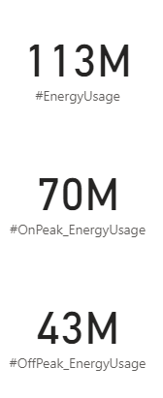
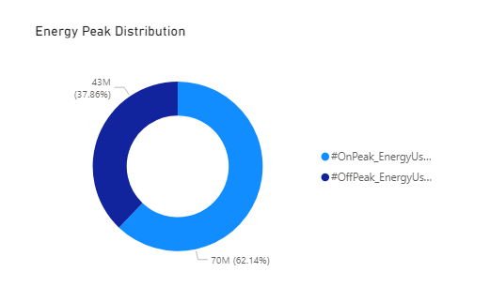
Created Measures:
Measure Column: #EnergyUsage
Shows the total Amount of Energy Used
#EnergyUsed = SumX( ‘PublishedData FaceAccountBilling’, ‘PublishedData FaceAccountBilling’[AccountEnergyUsage])
Measure Column: #OnPeak_EnergyUsage
Shows the total Amount of OnPeak Energy Used
#OnPeak_EnergyUsed = SumX( ‘PublishedData FaceAccountBilling’, ‘PublishedData FaceAccountBilling’[OnPeakEnergyUsage])
Measure Column: #OffPeak_EnergyUsage
Shows the total Amount of OffPeak Energy Used
#OffPeak_EnergyUsed = SumX( ‘PublishedData FaceAccountBilling’, ‘PublishedData FaceAccountBilling’[OffPeakEnergyUsage])
Notes:
Like when we create key measures! The measures are stored in Facts table in the sample pbix files.

Slide 5
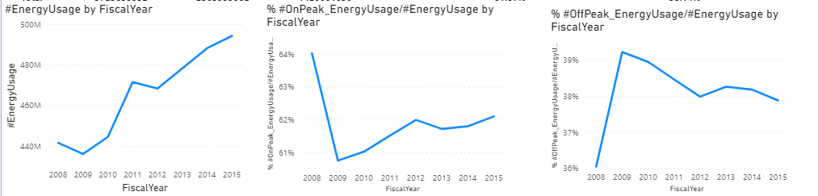
Measures Created
Measure Column: % #OnPeak_EnergyUsage/#EnergyUsage
Shows the Ratio of OnPeak Energy to Total Energy Usage
% #OnPeak_EnergyUsage/#EnergyUsage = Divide( [#OnPeak_EnergyUsage], [#EnergyUsage])
Measure Column: % #OffPeak_EnergyUsage/#EnergyUsage
Shows the Ratio of OffPeak Energy to Total Energy Usage
% #OffPeak_EnergyUsage/#EnergyUsage = Divide( [#OffPeak_EnergyUsage], [#EnergyUsage])
Notes:
Like when we create key measures! The measures are stored in Facts table in the sample pbix files.

Slide 6
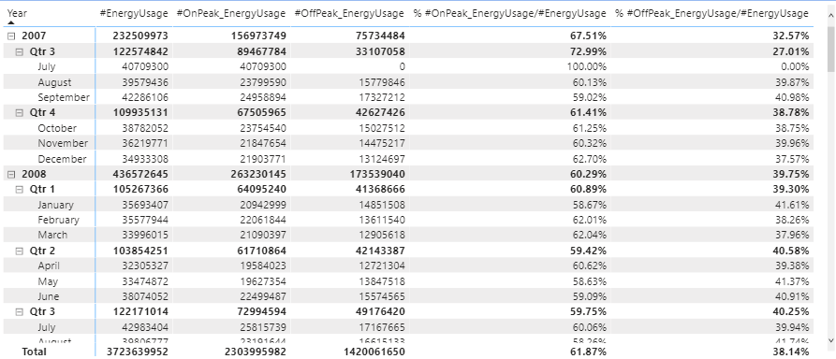
View
Notes:
Like when we create key measures! The measures are stored in Facts table in the sample pbix files.

Slide 7
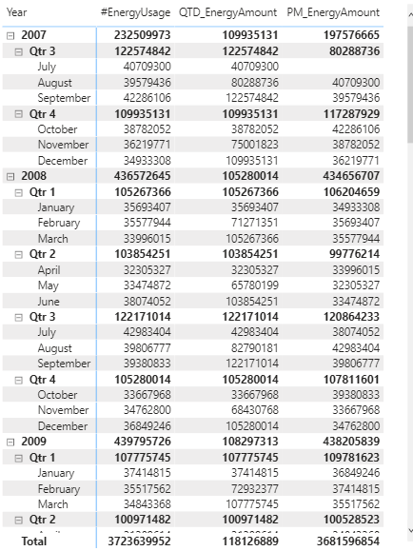
Measures Created
Measure Column: QTD_EnergyAmount
Shows the Quarter to Date Energy Amount
QTD_EnergyAmount = Calculate( [#EnergyUsage], DATESQTD(‘PublishedData Dates’[Date]))
Measure Column: PM_EnergyAmount
Shows the Previous Month’s Energy Amount
PM_EnergyAmount = Calculate( [#EnergyUsage], DATEADD(‘PublishedData Dates’[Date], -1, MONTH))
Notes:
Like when we create key measures! The measures are stored in Facts table in the sample pbix files.

Slide 8
Measures Created
Measure Column: %Total_EnergyUsage
Shows the % of Total Energy Usage
%Total_EnergyUsage= Divide( [#EnergyUsage], Calculate([#EnergyUsage], AllSelected( )), 0)
Notes:
Like when we create key measures! The measures are stored in Facts table in the sample pbix files.

Slide 9
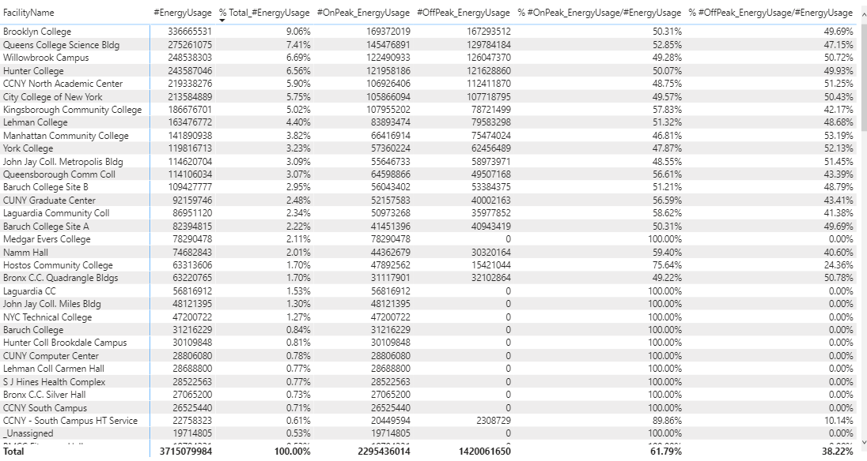
View
Notes:
Like when we create key measures! The measures are stored in Facts table in the sample pbix files.

Slide 10
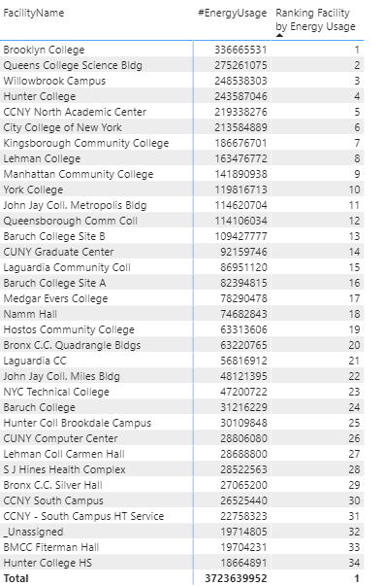
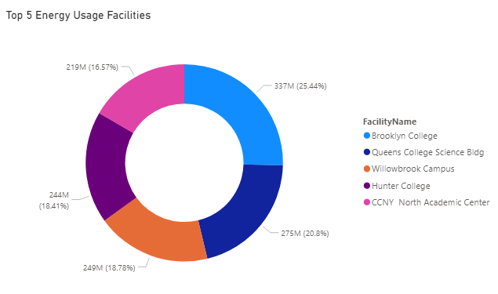
Measures Created
Measure Column: Ranking Facility by Energy Use
Ranks Facilities by their Energy Usage
%Ranking Facility by Energy Use = RankX( ALL (‘PublishedData DimFacility’[FacilityName]), [#EnergyUsage])
Notes:
Like when we create key measures! The measures are stored in Facts table in the sample pbix files.

Slide 11
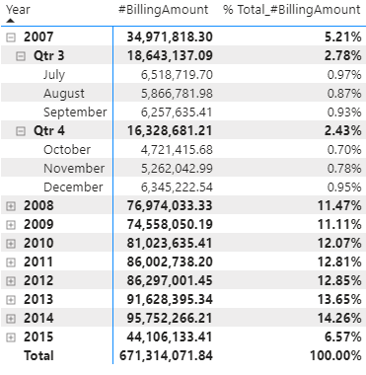
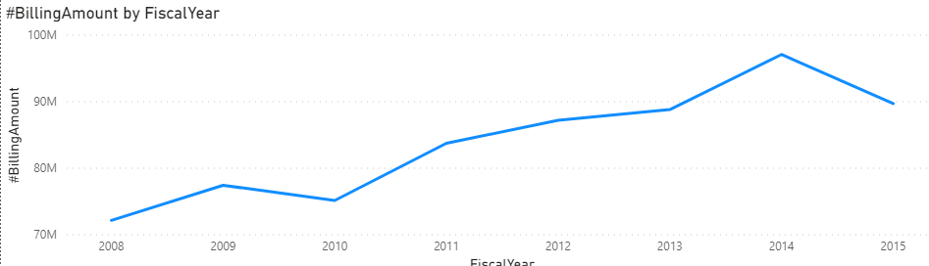
Measures Created
Measure Column: #BillingAmount
Shows the Total Billing Amount
#BillingAmount= SumX( ‘PublishedData FactAccountBilling’, ‘Publisheddata FactAccountantBilling’ [RevisedBilledAmount])
Measure Column: %Total_BillingAmount
Shows the % of Total Energy Usage
%Total_BillingAmount= Divide( [#BillingAmount], Calculate([#BillingAmount], AllSelected( )), 0)
Notes:
Like when we create key measures! The measures are stored in Facts table in the sample pbix files.

Slide 12
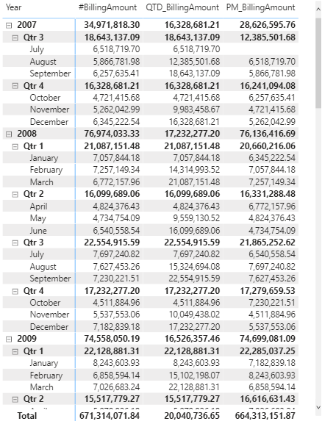
Measures Created
Measure Column: QTD_BillingAmount
Shows the Quarter to Date Billing Amount
QTD_EnergyAmount = Calculate( [#BillingAmount], DATESQTD(‘PublishedData Dates’[Date]))
Measure Column: PM_BillingAmount
Shows the Previous Month’s Billing Amount
PM_BillingAmount = Calculate( [#BillingAmount], DATEADD(‘PublishedData Dates’[Date], -1, MONTH))
Notes:
Like when we create key measures! The measures are stored in Facts table in the sample pbix files.

Slide 13
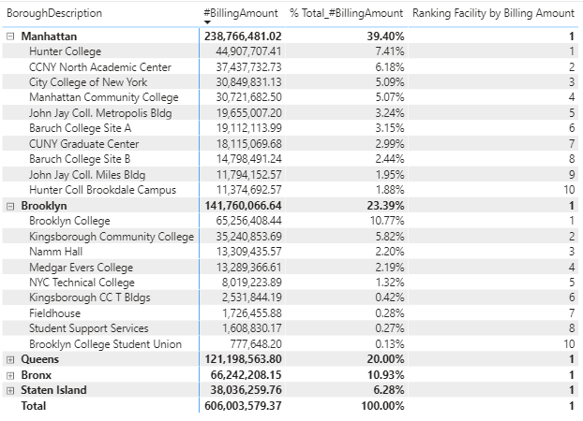
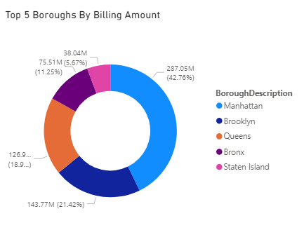
Measures Created
Measure Column: Ranking Facility by Billing Amount
Shows the Rank of Facilities by Billing Amount
Ranking Facility by Billing Amount= RankX( ALL (‘PublishedData DimFacility’[FacilityName]), [#BillingAmount])
Notes:
Like when we create key measures! The measures are stored in Facts table in the sample pbix files.

Slide 14
Measures Created
Measure Column: #FacilityAmount
Shows the Number of Facilities
#FacilityAmount= DistinctCountNoBlank(‘PublishedData DimFacility’[FacilityName])
Measure Column: Ranking Borough by Energy Amount
Ranks Boroughs by Energy Amount
Ranking Borough by Energy Usage = RankX( ALL (‘PublishedData DimFacility’[BoroughDescription]), [#EnergyUsage])
Measure Column: Ranking Borough by Billing Amount
Ranks Boroughs by Billing Amount
Ranking Borough by Billing Amount = RankX( ALL (‘PublishedData DimFacility’[BoroughDescription]), [#BillingAmount])
Measure Column: Ranking Borough by Facility Amount
Ranks Boroughs by Facility Amount
Ranking Borough by Facility Amount = RankX( ALL (‘PublishedData DimFacility’[BoroughDescription]), [#FacilityAmount])
Notes:
Like when we create key measures! The measures are stored in Facts table in the sample pbix files.

Slide 15
Measures Created
Measure Column: #Ratio_BillingAmount_FacilityAmount
Shows the Ratio of Billing to Facility Amount
Ratio_BillinAmount_FacilityAmount = DIVIDE([#BillingAmount], [#FacilityAmount])
Measure Column: Ranking Borough by Efficiency
Ranks Boroughs by Efficiency
Ranking Borough by Efficiency = RankX( FIILTER (ALL (‘PublishedData DimFacility’[BoroughDescription]), [BoroughDescription] <> BLANK( )), [Ratio_BillingAmount_FacilityAmount], ,ASC) - 1
Notes:
Like when we create key measures! The measures are stored in Facts table in the sample pbix files.

Slide 16
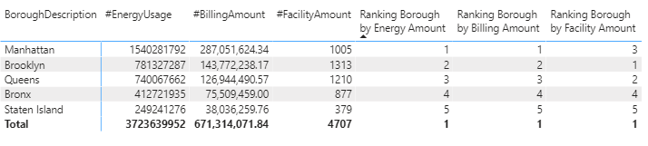
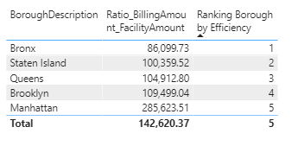
View
Notes:
Like when we create key measures! The measures are stored in Facts table in the sample pbix files.

Slide 17
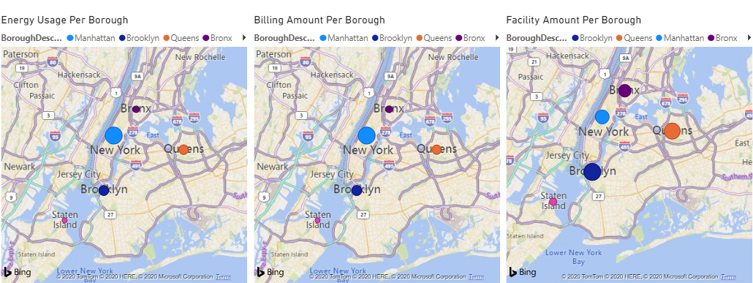
View
Notes:
Like when we create key measures! The measures are stored in Facts table in the sample pbix files.

Slide 18
Conclusion
By looking through the data, we can see there is a lot of interesting details that can be displayed
We observed the change in Energy and Bill Amount over quarters, months, and years
We found the main sources of energy usages, whether it be through boroughs, facilities, or On/OffPeak usage
We Ranked different Boroughs and Facilities based on their Energy Usage and Bill Amount
We also Ranked Boroughs for efficiency by finding the energy to facility usage
Notes:
.
.like using measures for visuals, rather than creating calculated coloumns and using them.
Also hiding the coloumns in tables
End by focusing on all the minor details

